Slide 1



FIDES INNOVA
Verifiable Computing Ecosystem
W W W . F I D E S I N N O V A . I O

Slide 2

FIDES INNOVA LABS
The Future is Verifiable
A pioneer in enabling secure computation across IoT and ML
Revolutionizing trust by introducing Agent-based Verifiable Computing
leveraging zero-knowledge proof (ZKP), DePIN and Agentic AI.

Slide 3
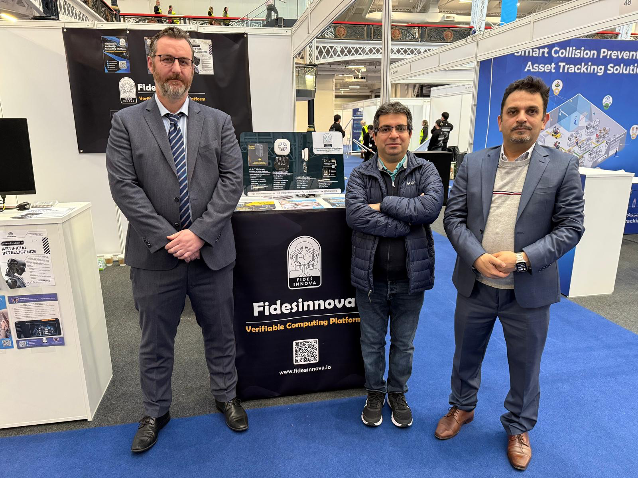
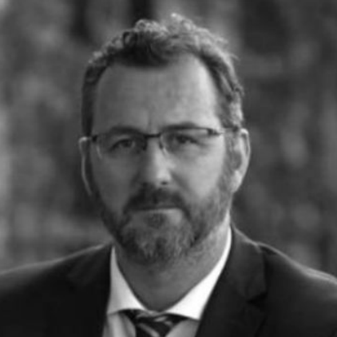
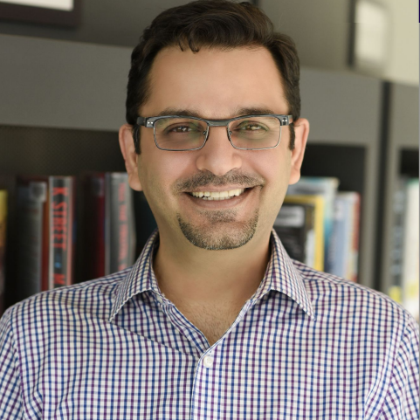
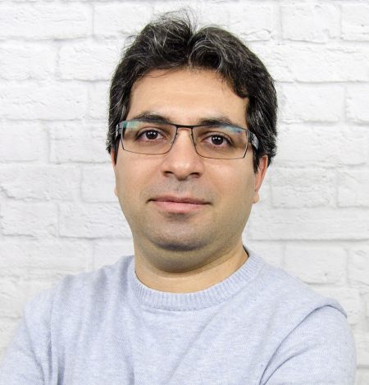
FOUNDERS
Mel McCann
Co-founder
Reza Ramezan, Ph.D.
Co-Founder
Former V.P. of Enterprise Technology at Cardano Foundation
Mel’s passion lies in exploring the infinite possibilities within the intersection of blockchain technology and business. Mel championed enterprise-grade blockchain applications across many fields such as law enforcement, education, provenance and nation-state certification during his time as V.P. at Cardano Foundation.
Former Research Lead at Cardano Foundation
With over 20 years of executive experience at leading firms like AT&T, Huawei, Telus, and Cardano Foundation, Reza is a proven innovator and entrepreneur. He holds a Ph.D. from the University of British Columbia and has numerous patents and publications in blockchain, zero- knowledge proofs, and IoT.
Hamed Shah-Mansouri, Ph.D.
Co-founder
With over 10 years of research and development experience, Hamed is a C-level executive with a Ph.D. in Electrical and Computer Engineering. He brings deep expertise in blockchain and cryptography, driving innovation at the intersection of technology and security.

Slide 4






PROBLEM
Trust in computation is implied, but not verified.
How can we trust the outputs of IoT devices or ML models if the computations behind them can't be verified?
Hacked U.S. vacuum robots are shouting racial slurs and pursuing pets.
Tesla tire pressure sensors are vulnerable to hackers.
Over 35,000 devices hacked at Saudi
Aramco, carrying out dangerously unsafe actions.
Firmware Tampering and Code Injection: The ShellShock attacks to execute arbitrary commands.

Slide 5
MARKET ANALYSIS
Total Addressable Market
(TAM)
Serviceable Addressable Market (SAM)
Serviceable Obtainable Market (SOM)
IoT Market by 2025 (source: Statista): $1.6 trillion
Estated Verifiable Computing: ~5% = $80 billion
Global cloud computing market by 2028 (source: Grand View Research): $1.2 trillion
Estated Verifiable Computing in Cloud computing: ~5% = $60 billion
AI Market by 2030 (source: Statista): $1.8 trillion
Estated Verifiable Computing in AI : ~5% = $80 billion
Industrial Sectors Market by 2028 (source: Fortune Business Insights): $300 trillion
Estated Verifiable Computing in Industrial Sectors : ~5% = $15 billion
Total TAM for Verifiable Computing: $245 billion
Geographic Focus
Fidesinnova operates globally: ~50% of the TAM
Fidesinnova operates in North America: ~20% of the TAM
Customer Segments
Fidesinnova operates targets enterprises and industries with high security and compliance requirements (e.g., healthcare, finance, manufacturing): ~30% of the TAM
Total SAM for Verifiable Computing: $73 billion
Market Penetration
As a niche player in verifiable computing, FidesInnova is projected to capture approximately ~1% of the market.
Competition
Competitors include startups such as IoTex, RiscZero, StarkWare.
Fidesinnova’s ability to differentiate through vertical-specific solutions will be key.
Estimated SOM: 1% of SAM = $730 million
Reference:
Link: Statista IoT Market Report
Link: Grand View Research Cloud Computing Report
Link: Statista AI Market Report
Link: Fortune Business Insights Industrial Automation Report
Example: Messari Report on zk-Rollups.
Example: Gartner Top 10 Strategic Technology Trends.
Example: McKinsey Industrial Automation Report.

Slide 6


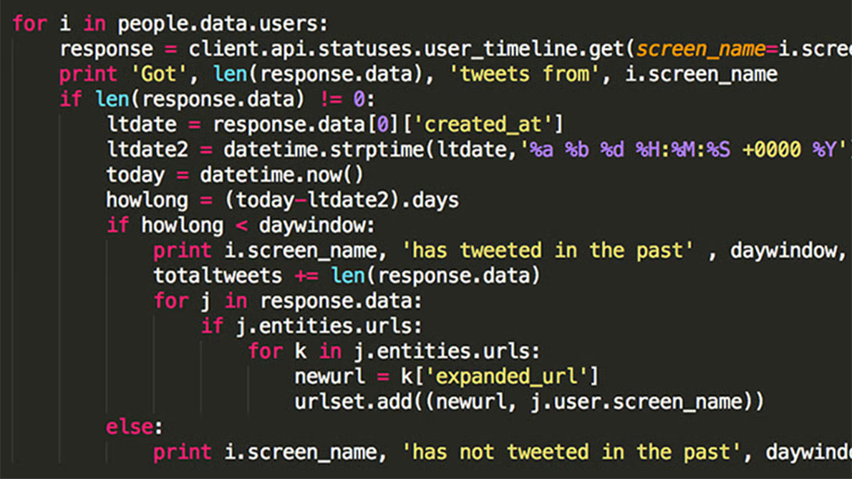



FIDES INNOVA SOLUTION
Verifiable Computing
We provide technology that guarantees the correct execution of programs on devices—without revealing their code.
Program Commitment
Public
Blockchains
Execution
Proof
User

Slide 7
FIDES INNOVA SOLUTION
Technology
Zero-knowledge Proof (ZKP)
Blockchain, DePIN
Agentic AI
Internet-of-Things (zk-IoT) - Patented

Slide 8
FIDES INNOVA SOLUTION
Verifiable Computing
We offer two AI-Powered Security Agents:
🔐 AI Agent 1 – Commitment Generator
Assists developers in integrating Zero-Knowledge Proof (ZKP) into their applications in under a minute.
🛡️ AI Agent 2 –Security Verifier Assists users to query whether a program or device has not been compromised.

Slide 9


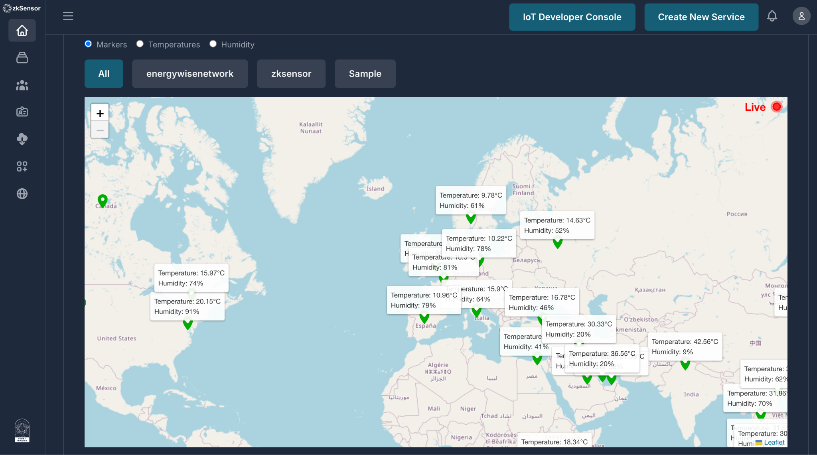
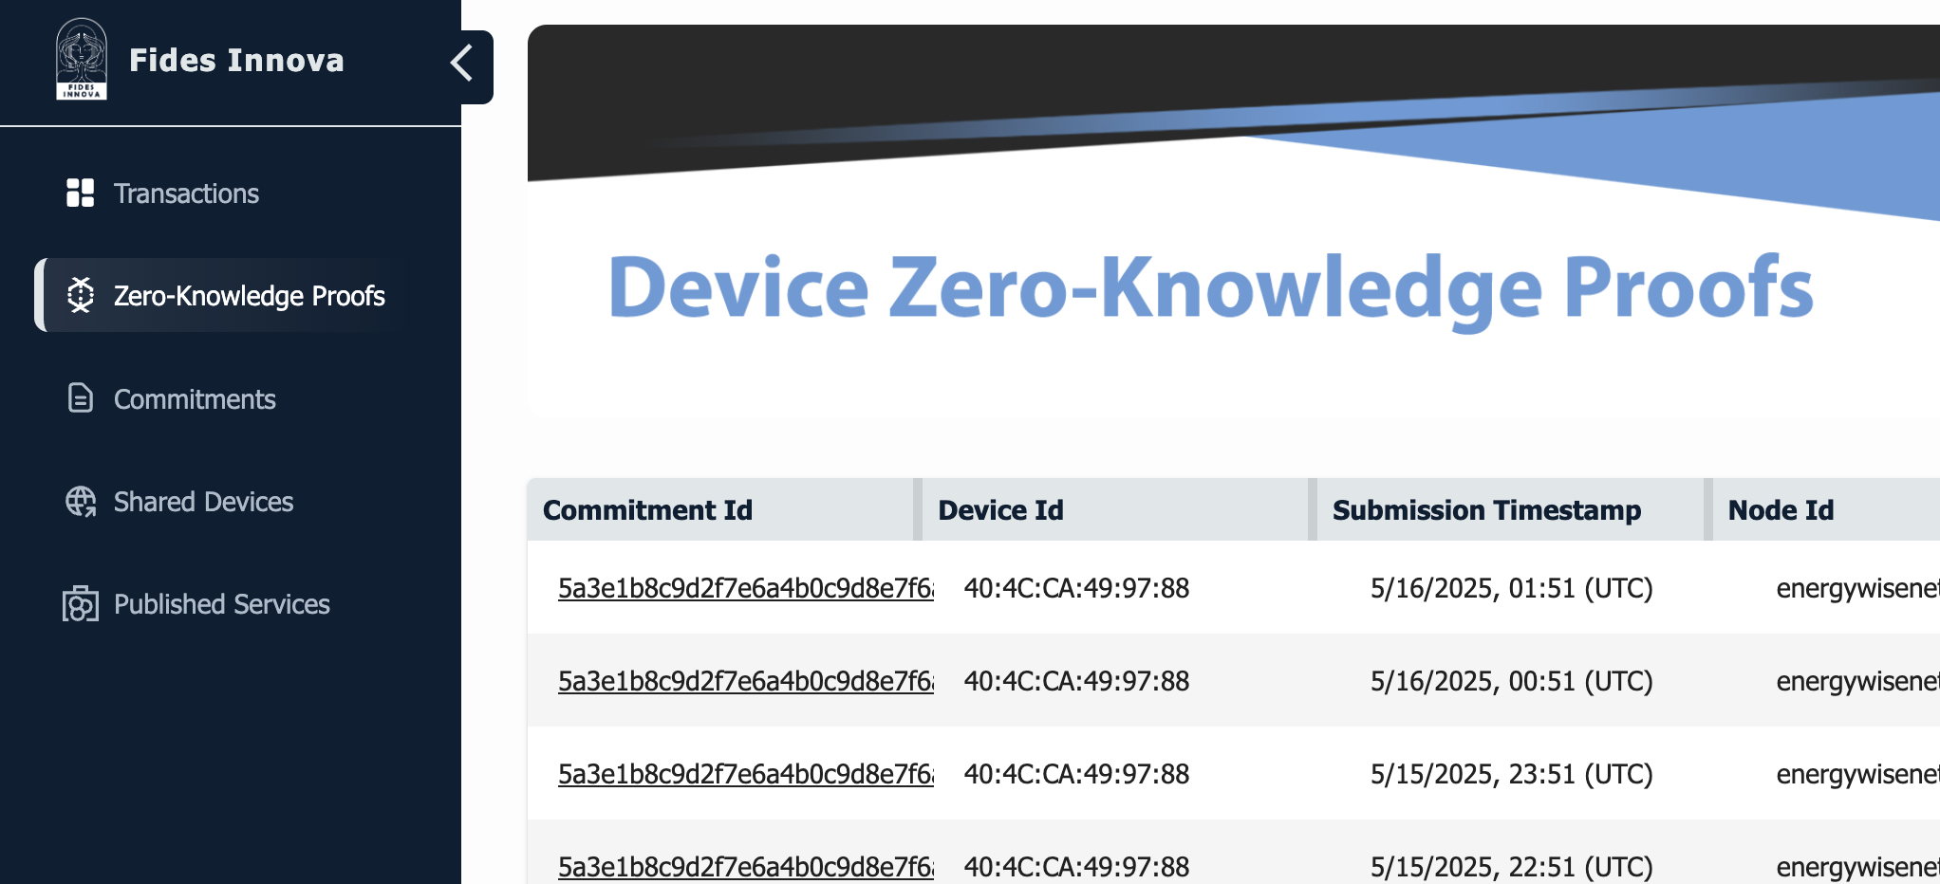
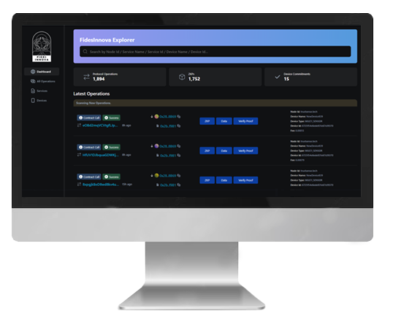
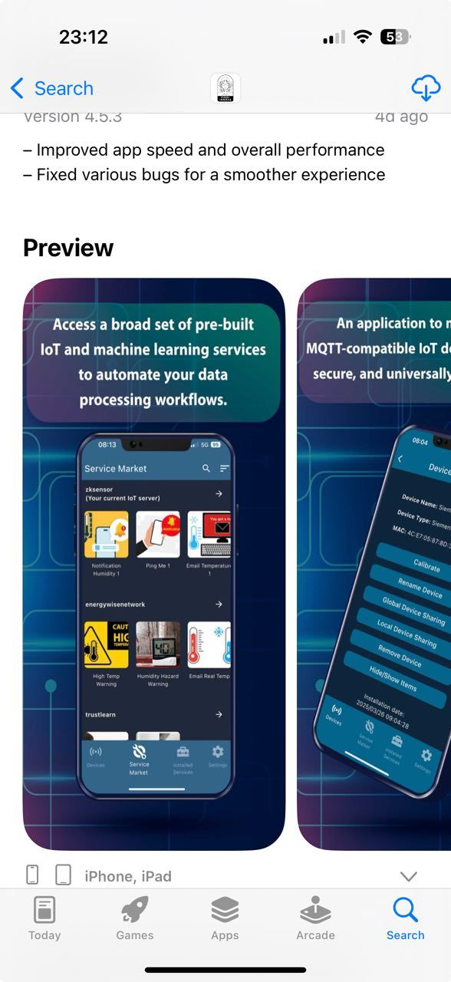


FIDES INNOVA PRODUCTS
Blockchain-based Device Management Servers
Verifiable Computing Explorer
Devices Management Mobile App
🔐 AI Agent 1
Commitment Generator
🛡️ AI Agent 2 Security Verifier

Slide 10






Business
Technology Layers
Use Cases
Energy
Smart Home
Healthcare
Transportation
Fidesinnova Verifiable Computing Nodes
Frontend
Web 3.0 Device
Mobile App
Management Web App
Service Market
Backend
Fidesinnova
Blockchain
Blockchain-based
IoT Server
Network ZKP
Explorer
Core Technology
Service Contract Protocol
(Blockly)
Next-generation ZKP for Verifiable Computing (C++, Rust)

Slide 11
BUSINESS ARCHITECTURE
Technology Layer -> Clients
Revenue Generation
Frontend -> End Users
1- Service execution fee See IoT/SERVICE USER pricing in the next slides
2- Verifiable Computation (VC) Developer account
3- Pay transaction fee
4- VC server/node license
See PACKAGE A-B-C pricing
Backend -> IoT Vendors
Core Technology -> Technology Developers
5- ZKP SDK update
See PACKAGE ENTERPRISE pricing
Platform
6- Tokenomics

Slide 12
PRICING
Package A
Verifiable Computing
(VC) Starter
Package B
Verifiable Computing
(VC) Intermediate
Package C
Verifiable Computing
(VC) Professional
Enterprise
Package
IoT USER
Service USER
Free
Pay-per-Use
$0.01
$200,000
Quote
$20,000
$100,000
Create accounts on servers
Install free services from the Service Market
Install and manage devices via mobile or web
Share your device and monetize your IoT data
Create accounts on servers
Install paid services from the Service Market
Submit the ZKP transaction to the network for verification purposes.
1 VC server/node license
10 VC Developer accounts on servers for one year.
500 device/program commitments submission per year.
10,000 device proof submission per day.
Write and list service contracts in the Service Market
Updating ZKP SDK based on user needs.
More VC Developer accounts.
More device/program commitments .
More proof submission
1 VC Developer accounts on servers for one year.
5 device/program commitments submission per year.
25 device proof submission per day.
Write and list service contracts in the Service Market
3 VC Developer accounts on servers for one year.
50 device/program commitments submission per year.
500 device proof submission per day.
Write and list service contracts in the Service Market

Slide 13
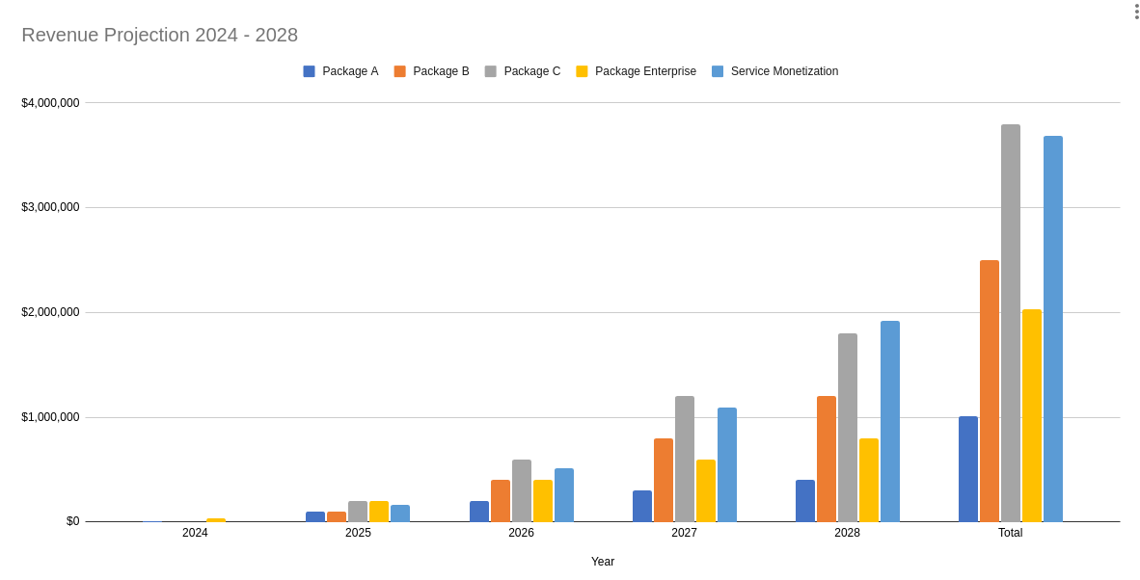
REVENUE PROJECTION 2025-2028
Year | 2024 | 2025 | 2026 | 2027 | 2028 | Total
Service Monetization | $0 | $164,250 | $511,000 | $1,095,000 | $1,916,250 | $3,686,500
Package A | $10,000 | $100,000 | $200,000 | $300,000 | $400,000 | $1,010,000
Package B | $0 | $100,000 | $400,000 | $800,000 | $1,200,000 | $2,500,000
Package C | $0 | $200,000 | $600,000 | $1,200,000 | $1,800,000 | $3,800,000
Package Enterprise | $30,000 | $200,000 | $400,000 | $600,000 | $800,000 | $2,030,000
Revenue from token sale and transactions not taken into account here.

Slide 14
CURRENT STATE - Traction
Team - Q2 2025
We are a team of twenty
Headquartered in Canada
Self-funded
Founders
Hardware engineers
Blockchain engineers
IoT & web & mobile developers
Partners
Current Verifiable Computing Network Servers/Nodes

Slide 15
ROADMAP
2025-2026
ZKP Research
Mobile/Web/Node Development
Business growth strategy
ZKP explorer Development
Business development initiations
Digital Marketing Team
Business development in transportation sector (North America)
Agentic AI
Business development in energy sector (Asia-Pacific)
Business development in healthcare sector (Asia-Pacific)
Starting Token Launch
2024
2025
2026
2023
Q1
Q2
Q3
Q4
Q1
Q2
Q3
Q4
Q1
Q2
Q3
Q4
B2B/B2C marketing strategy development
zK-IoT scheme
ZKP SDK
Partnership expansion
Business development in energy sector (North America)
Business development in blockchain sector (North America)
AI Agent Service Market
Sales in Digital Building Twin Sector (North America)
Business Development in transportation sector (Asia-Pacific)
2023-2024

Slide 16
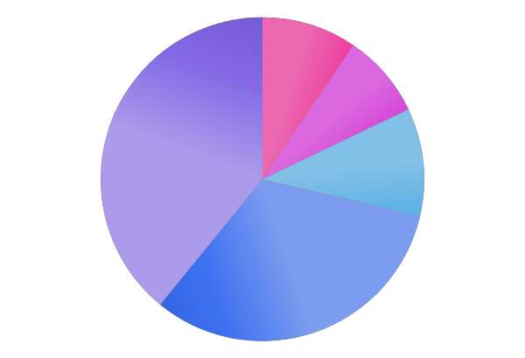
EXTENDING RUNWAY TO ACHIEVE OUR GOALS
Support Services
10%
Technology Development
39%
Office Operation
8%
Required Funding: 12-18 Months Runway
$1.5 Million USD
Legal & Accounting
11%
Business Development
32%

Slide 17







Ask our AI Agen about Fides Innova
CONTACT US
www.fidesinnova.io
info@fidesinnova.io
http://llm.fidesinnova.io:8501
fidesinnova
fidesinnova
fidesinnova
fidesinnova
Invest in Fidesinnova, and become an architect of trust for the world’s IoT devices

